Slide 1


Slide 2
Empowering the nation
By Molemo, Callon & Ryan

Slide 3


Slide 4
Members

Slide 5

Leader
Molemo

Slide 6
Leader
Molemo

Slide 7

Project manager
Callon

Slide 8
Project manager
Callon

Slide 9

Project manager
Ryan

Slide 10
Project manager
Ryan

Slide 11
Logo and background progress

Slide 12



Initial designs of logo

Slide 13
Final decision of logo

Slide 14


Background progression
#92a48b
Final choice
Initial choice

Slide 15


Slide 16
Our purpose
Empowering the Nation was established in 2018 and offers courses in Johannesburg. Hundreds of domestic workers and gardeners have been trained on both the six-month long Learnerships and six-week Short Skills Training Programs to empower themselves and can provide more marketable skills.

Slide 17


Slide 18
Business case
A local small- to mid-size enterprise (SME) would like to have a web page and mobile app developed to advertise their business, receive requests for information from potential customers as well as provide quotes to the potential customers for services requested.

Slide 19


Slide 20
Website screenshots

Slide 21
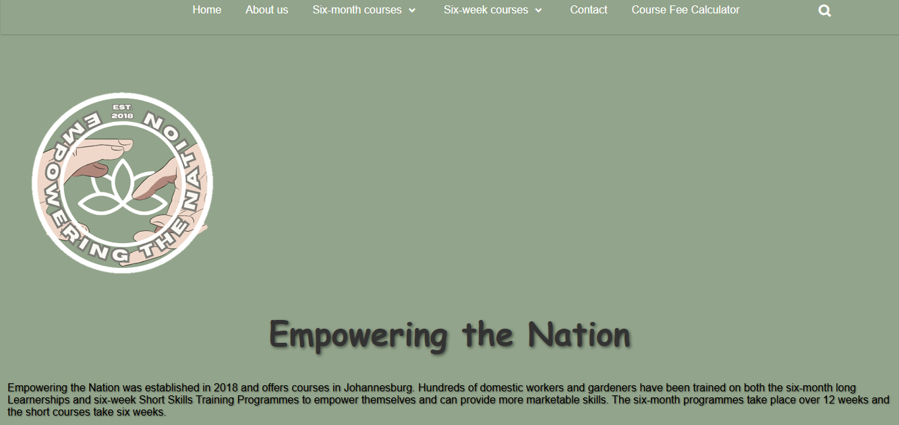
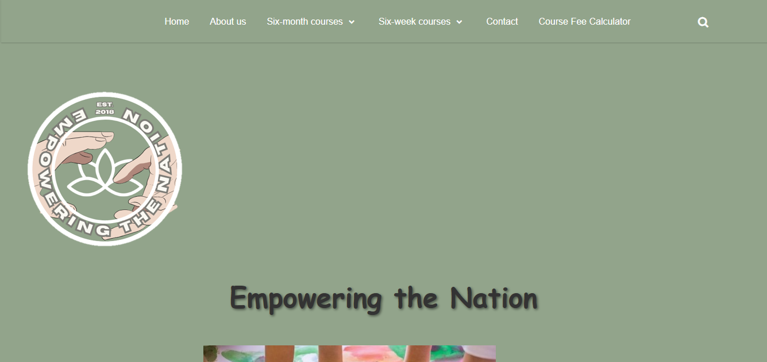

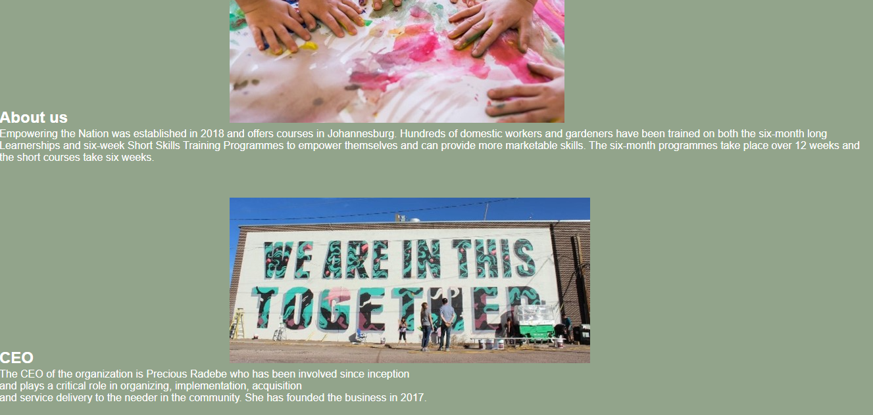

Home
About us

Slide 22
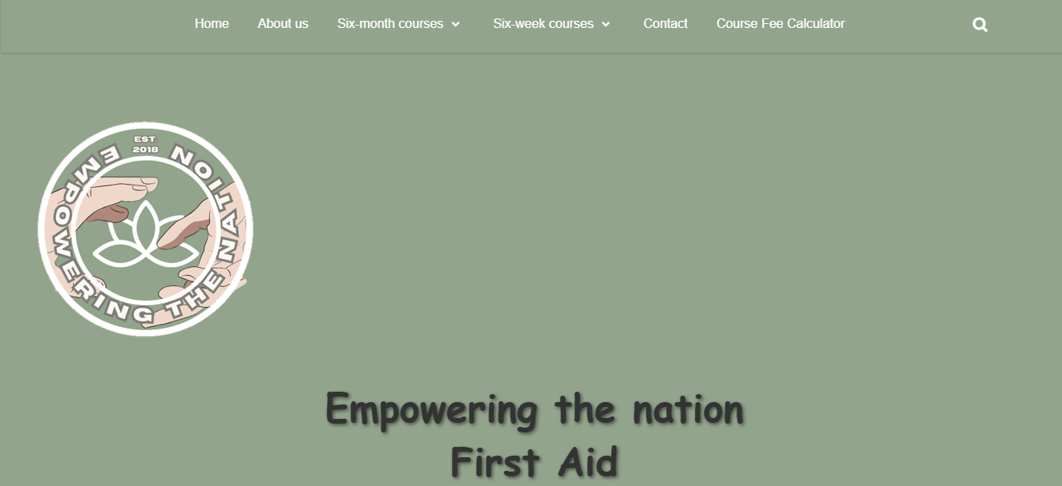
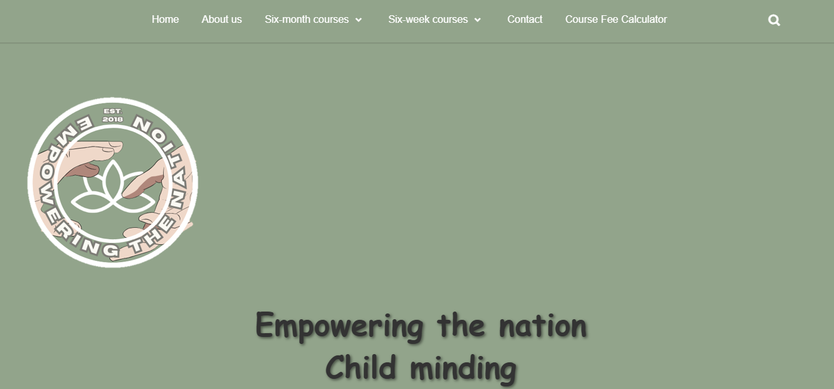


6-week course example
6-month course example

Slide 23
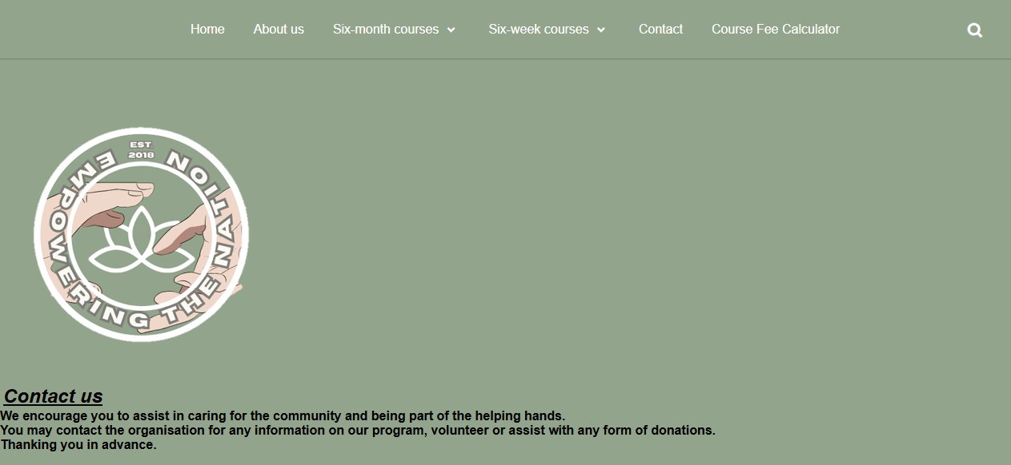
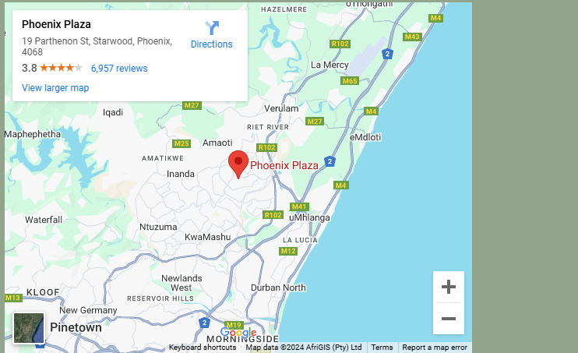
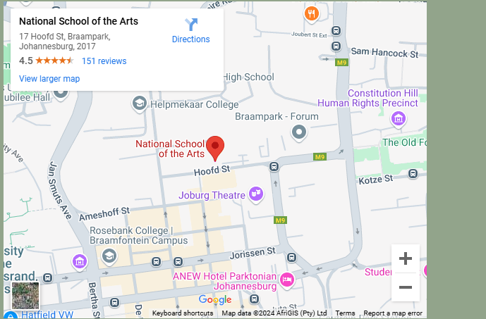
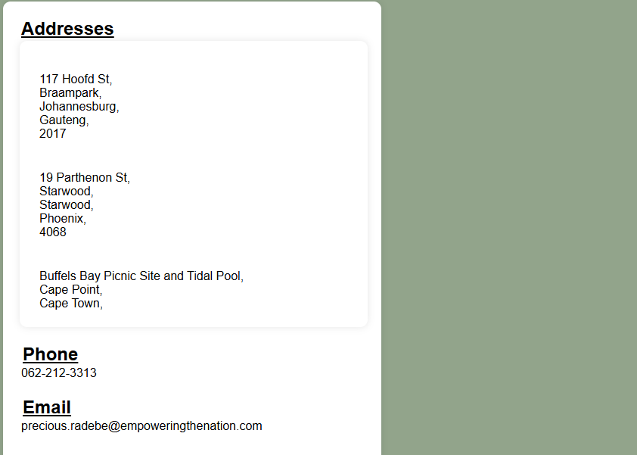


Contact page

Slide 24
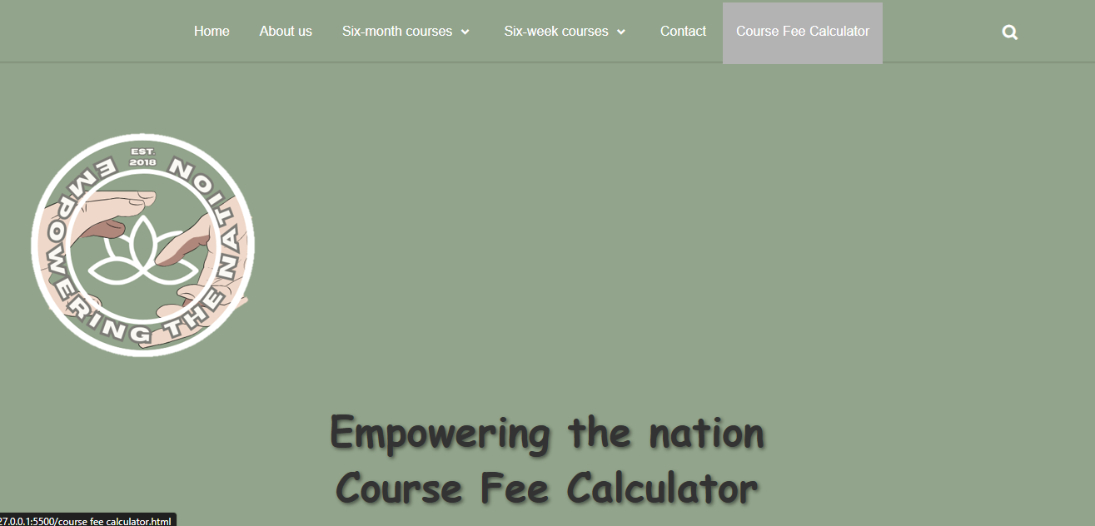

Calculation

Slide 25
Website testing

Slide 26


Slide 27
Mobile app screenshots

Slide 28

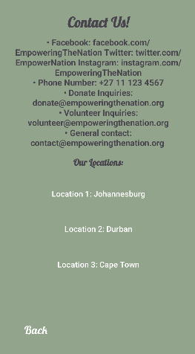

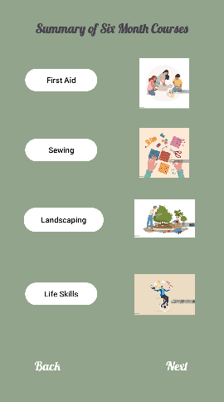

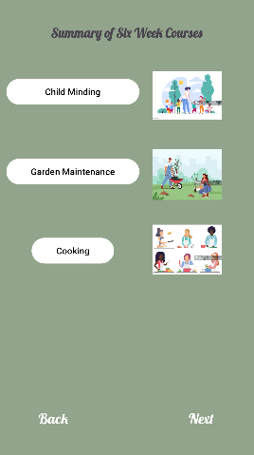
6-month course example
Example of course
Registration & calculation
Contact
Home
6-week course example

Slide 29
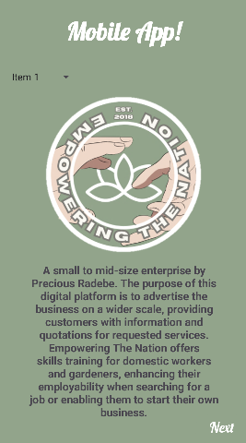

Contact
Home
Example of course
6-month course example
6-week course example
Registration & calculation

Slide 30
App testing

Slide 31


Slide 33
Figma screenshot (wireframes)

Slide 34
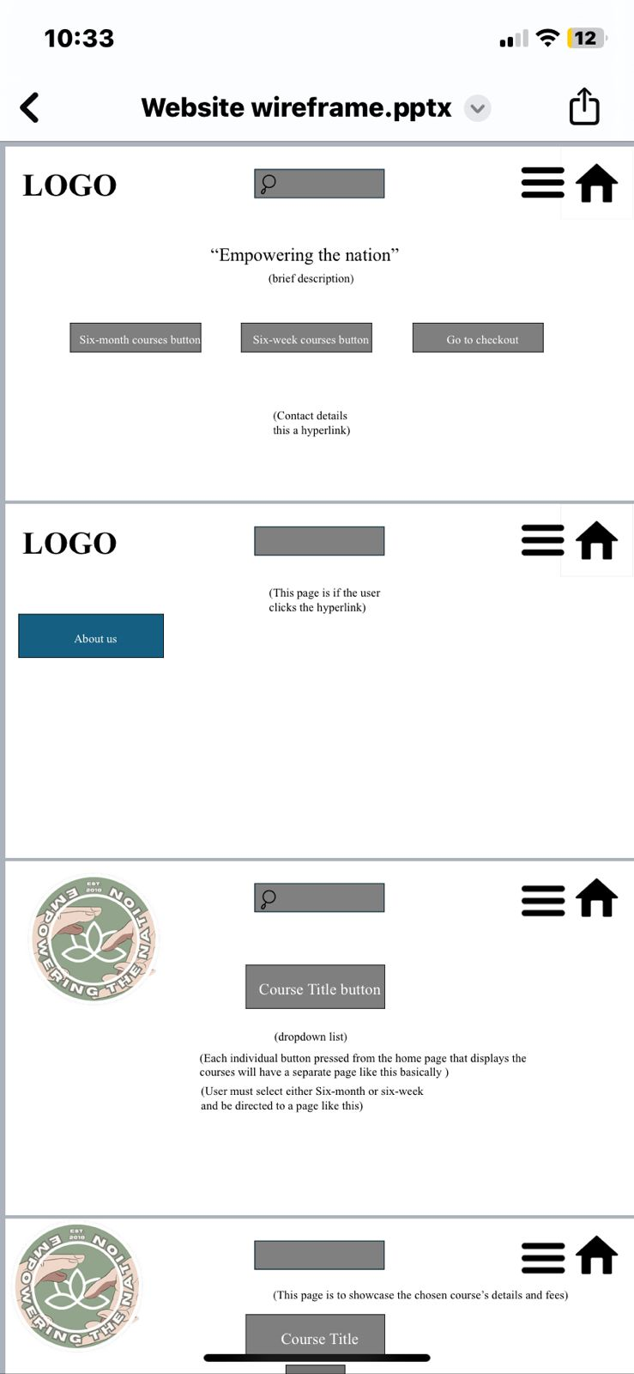
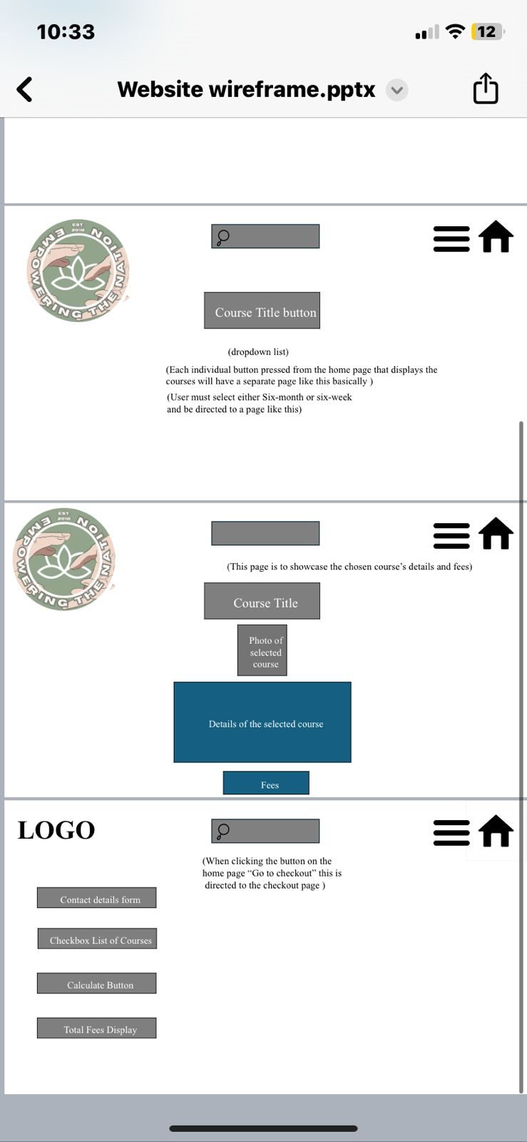
Website

Slide 35
Website

Slide 36
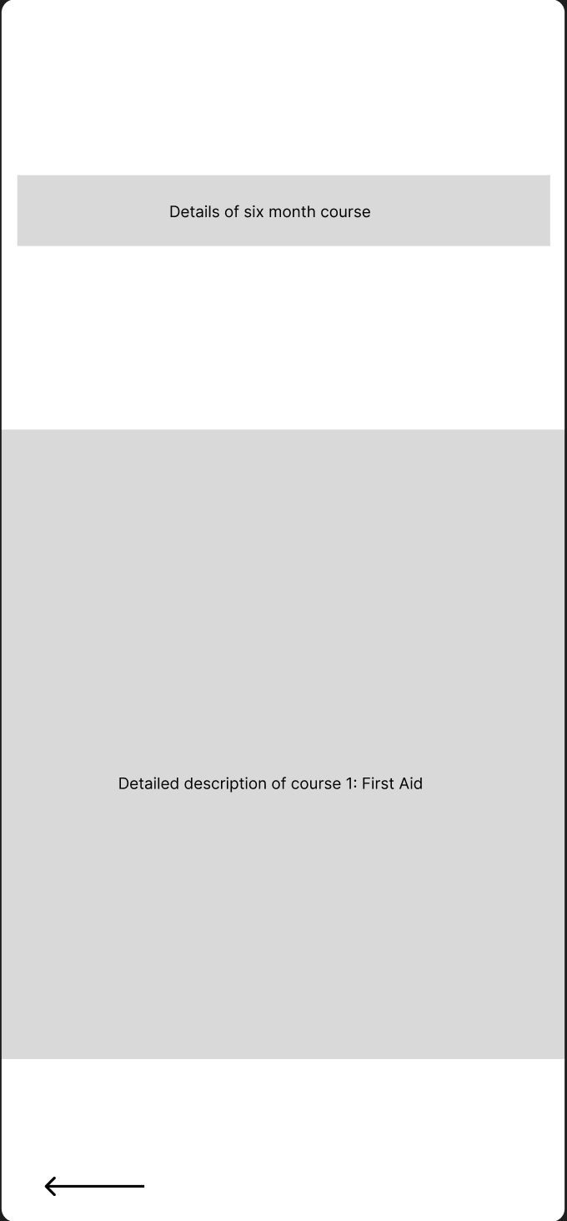
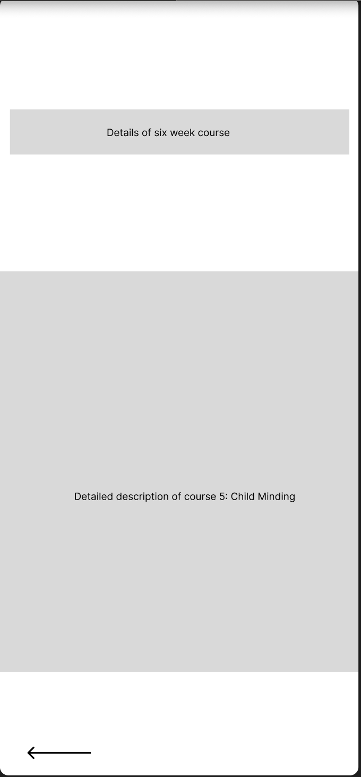
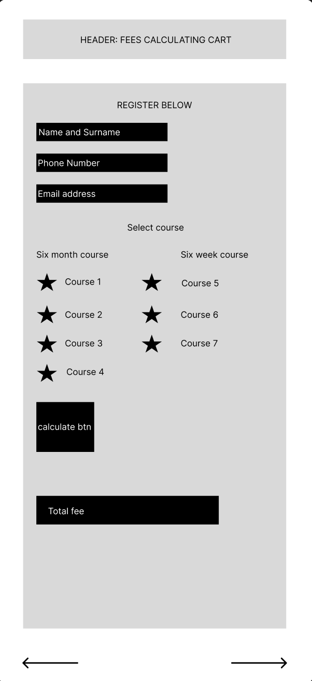
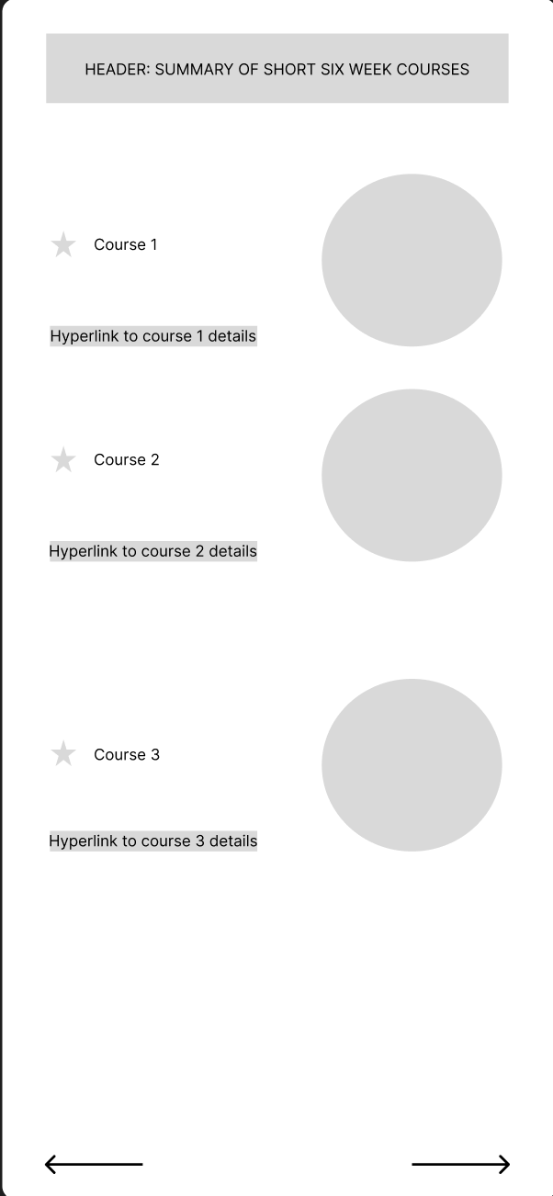
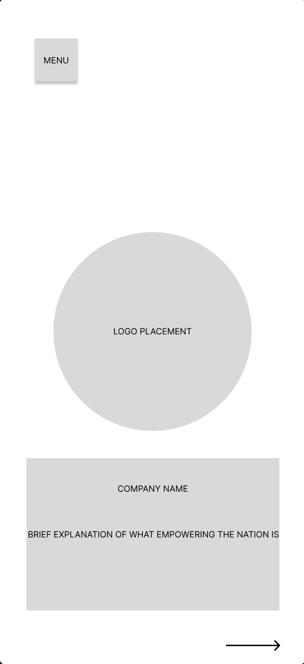
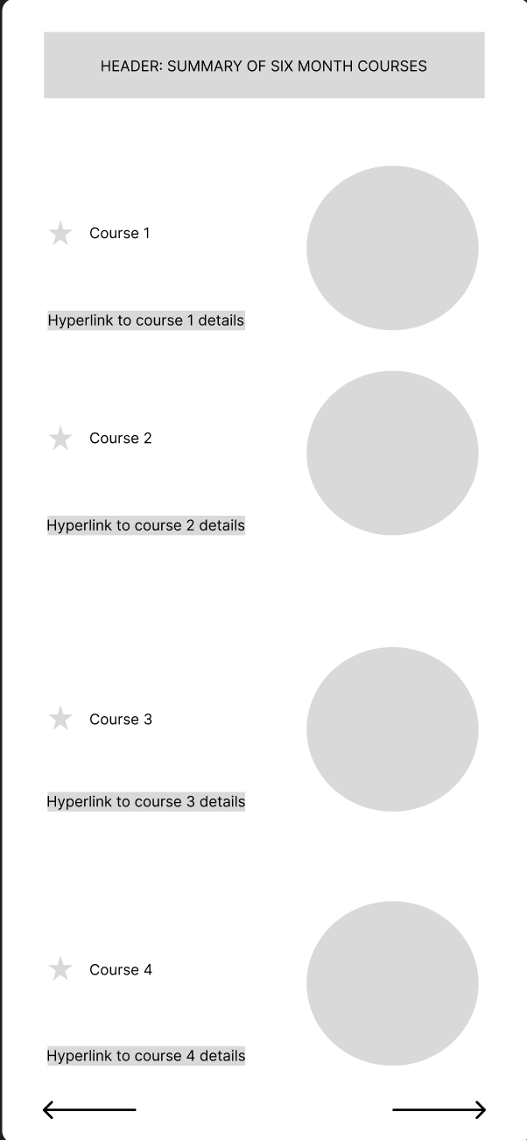

App

Slide 37
App

Slide 38

THANK YOU!

Slide 39
THANK YOU!

